Slide 1
MDB
Collaborative Design
Feb. 2016. Barcelona

Slide 2
Collaborative Design
What is Collaborative Design ?
K-acceleration and social changes
… design is in part the result of complex
collective behavior and actions.
Teams, communities and crowds
… relevant function in the future.
Collaborative design
…influence, involvement and participation of all kind of stakeholders in design processes.

Slide 3
Collaborative Design
M1. Collective design
A11. Social Design.
A12. Creativity and technology
M2. Data driven design
A21. Design & data analytics.
A22. Design processes in complex systems.
M3. Collaborative design research
A31. Innovation-research in collaborative design*.
A32. Methods and processes of CD research.

Slide 4
Collaborative Design
M1. Collective design
A 11. Social Design.
Role of communities and crowds in designing for people and with people.
Socio-economic behaviour and innovation.
Stakeholders and organisational context of co-design.
Design and entrepreneurship

Slide 5
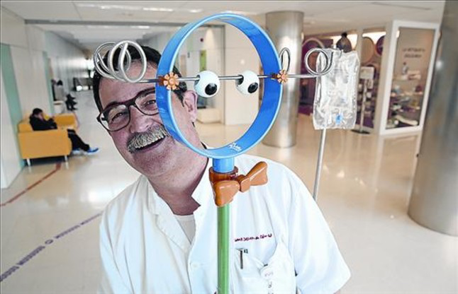
GRCD - UPC
Collaborative Design
M1. Collective design
A 11. Social Design.
Everybody is involved
Notes:
Guillermo Puche: "Hi ha un munt de bones idees oblidades en calaixos"
Infermer creatiu. Un tímid gargot seu ha acabat exposat al Museu del Disseny.
DISSABTE, 21 DE MARÇ DEL 2015
RICARD CUGAT
Tenia tot just 19 anys quan va entrar com a portalliteres a l'Hospital Sant Joan de Déu, on ha treballat durant 38 anys fins a aconseguir el seu actual càrrec d'adjunt a la Direcció Infermera. Poc amic dels focus, la seva idea d'adaptar un vulgar porta-sèrum a l'univers infantil li ha donat un protagonisme que suporta amb un mig somriure.
-¿El Pal-Joc és el seu primer invent?
-Sí, ¡però jo no sóc inventor! Tot això ha sigut un agradable accident.
-Però la idea original és seva.
-Això sí. En la meva feina diària observava que els nens ingressats s'enfilaven als pals porta-sèrum perquè els seus pares els arrosseguessin pels passadissos.
-Són nens i juguen.
-És clar, però és un suport pensat perquè el pacient que porta una via tingui certa autonomia de moviments i la base és molt inestable. Els nens poden caure i arrossegar darrere seu l'ampolla de sèrum i l'agulla. Prohibir que els nens s'enfilin al pal hauria sigut una guerra perduda, de manera que s'havia de trobar una solució al problema.
-¿Per on va començar?
-Un dia vaig dibuixar un pal porta-sèrum amb una plataforma estable i una mena de manillar per subjectar-s'hi. A partir d'aquí tot el que va passar no ho vaig buscar jo. Si no s'haguessin alineat una sèrie de circumstàncies, aquell dibuix no hauria sortit mai del calaix de la meva taula.
-¿Per què?
-Jo no havia fet mai res així... ¡però si ni tan sols sé dibuixar! En un altre context m'hauria fet vergonya ensenyar aquell gargot, però feia poc s'havia creat a l'hospital una Direcció d'Innovació i Investigació i al capdavant hi havia una persona amb qui jo tenia confiança. Segur que hi ha un munt de bones idees oblidades en calaixos per no saber com canalitzar-les, per vergonya i per por.
-La seva va tenir èxit.
-Vaig presentar la idea el 2008 i a partir d'aquí vam muntar un grup de treball amb personal de l'hospital per millorar el meu dibuix, vam consensuar un model i es va fer un prototip de fusta. Després es va contactar amb l'escola Llotja i els estudiants de disseny van agafar la idea com a projecte de curs. Al cap d'uns mesos ens van presentar 20 dissenys diferents, i si un era xulo l'altre encara n'era més.
-No devia ser fàcil triar-ne un.
-Els vam exposar a l'hospital, vam posar una urna i vam convidar pacients, familiars i professionals a votar el seu projecte preferit. Després es va buscar un mecenes, l'hotel Le Meridien Ra Beach de Calafell, i el 2013 ja teníem 20 unitats de Pal-Joc.
-¿I funciona?
-És difícil objectivar els resultats, però millora el benestar emocional del pacient i l'ajuda a acceptar el tractament perquè se'l pren com un joc. Després de veure l'ús que se n'ha fet -dels 20 només n'hi ha 3 en perfectes condicions-, diria que sí.
-¿Ha tingut més idees?
-Jo no, però estic convençut que aquesta experiència ha animat altres persones de l'hospital a posar en pràctica les seves idees. Per exemple, un grup d'infermeres de la planta de neurologia han ideat un encoixinat de colors perquè els nens no es donin cops amb les baranes dels llits fet a base de xurros de goma espuma típics de piscina oberts per la meitat.
-¡Qui li hauria dit que el resultat de la seva idea acabaria exposat al Museu del Disseny i que el FAD el convidaria a parlar de disseny i transformació social!
-És increïble veure que existeixen tantes idees que faciliten la vida de la gent. Jo crec en la innovació amb la finalitat de resoldre problemes, i per resoldre'ls s'ha de ser prou sensible per anar allà on són els problemes. http://estaticos.elperiodico.com/resources/jpg/1/9/1426895247091.jpg?_ga=1.222894683.1959947020.1446531113

Slide 6
Collaborative Design
M1. Collective design
A 11. Social Design.
References
Design for Networked Learning. Peter B. Sloep. (2015) In The Future of Ubiquitous Learning. Part of the series Lecture Notes in Educational Technology.
Social Physics: How Good Ideas Spread-The Lessons from a New Science. (2014) Alex Pentland. Penguin Press.
The Social Design of Technical Systems: Building technologies for communities. Brian Whitworth. (2014). The Interaction Design Foundation.
Building Successful Online Communities: Evidence-Based Social Design. (2011) Robert E. Kraut et al. MIT Press.

Slide 7
Collaborative Design
M1. Collective design
A12 Creativity and technology
Creative management of technology in integrated systems.
Practical creativity for innovation.
Design of processes and products based in high-performance computing.
Forecasting and scenario planning.

Slide 8
Collaborative Design
M1. Collective design
A12 Creativity and technology
Creative | 25% $ + 36% | 13 % $ + 80%
Routine | 45% $ - 37% | 17 % $ - 17%
 | Local | Traded
Occupation category
Industry categories

Slide 9
Collaborative Design
Collaborative Design
M1. Collective design
A12 Creativity and technology
References
Connor, A.M. (2016). A historical review of creative technologies. In A.M. Connor & S. Marks (Eds.) Creative Technologies for Multidisciplinary Applications. Hershey: IGI.
Creativity—A Framework for the Design/Problem Solving Discourse in Technology Education. (2005). Theodore Lewis. Journal of Technology Education V. 17.
Creativity in the age of emerging technology: Some issues and perspectives in (2010). JM Burkhardt, T Lubart. Creativity and innovation management. Wiley Online Library.
Technology and tolerance: The importance of diversity to high-technology growth. (2013). R Florida, G Gates. Research in Urban Policy.
Accelerate. How the most innovative companies capitalise on today’s rapid-fire strategic challenges – and still make their numbers. (2012). John P. Kotter. Harvard Business Review.

Slide 10
Collaborative Design
M2. Data driven design
A21. Design & data analytics
Data driven process of innovation
Big data in services and products design.
Individual and social value from data analytics.
Personalized experience of individuals and groups with products, services and brands.

Slide 11
Collaborative Design
M2. Data driven design
A21. Design & data analytics
Monitoring everything

Slide 12
Collaborative Design
M2. Data driven design
A21. Design & data analytics
References
Data-Informed Product Design. (2015). Pamela Pavliscak. O'Reilly
Data scientist. (2012) TH Davenport, DJ Patil - Harvard Business Review.
The real-time city? Big data and smart urbanism (2014). Rob Kitchin. V. 79
Innovations with Smart Service Systems: Analytics, Big Data, Cognitive Assistance, and the Internet of Everything, (2015). Demirkan, Haluk et al. Communications of the Association for Information Systems. V. 37
The Effects of the Internet of Things and Big Data to Organizations and Their Knowledge Management Practices. (2015). Jari Kaivo-oj et al. Knowledge Management in Organizations. V. 224 Lecture Notes in Business Information Processing

Slide 13
Collaborative Design
M2. Data driven design
A 22. Design processes in complex systems
Systems thinking to understand and design large-scale, complex challenges.
Social and physical interconnections.
Business Model Innovation through design disciplines.
Sustainability of products and services.

Slide 14
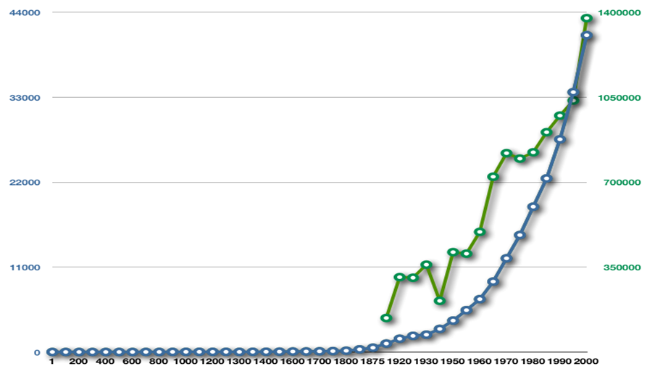
Collaborative Design
M2. Data driven design
A 22. Design processes in complex systems
GDP
World Patent filling
Exponential K
Notes:
máster en marketing de telecomunicaciones
14

Slide 15
Collaborative Design
M2. Data driven design
A 22. Design processes in complex systems
References
Learning the Building Blocks of Service Innovation from SMEs. (2015). Prindible, Matt; Petrick, Irene. Research Technology Management. V. 58 Issue 5
From Risk to Resilience: Learning to Deal With Disruption. (2015). Fiksel, Joseph et al. MIT Sloan Management Review.
The evolution, challenges, and future of knowledge representation in product design systems (2013). SK Chandrasegaran et al. Computer-aided Design.
Applying the design structure matrix to system decomposition and integration problems: a review and new directions. (2001). Browning, T.R. Engineering Management, IEEE.
The designer's role in facilitating sustainable solutions. (2008). DC Wahl, S Baxter - Design Issues. MIT Press.

Slide 16
Collaborative Design
M3. Collaborative design research
A31. Innovation-research in collaborative design *.
A32. Methods and processes of CD research.
Critical revision of theoretical models in collaborative design and innovation.
Design knowledge production
Design driven research-innovation

Slide 17
Collaborative Design
M3. Collaborative design research
A31. Innovation-research in collaborative design *.
A32. Methods and processes of CD research.
Technology
& science
Integrated services & business models
People
& Society
“Design driven innovation” driving forces
Notes:
Networks prosper & large companies decline.
Technology empowers a low impact, high-tech business model.
Maximise flexibility & minimise fixed costs.
Social conscience and green responsibility.
Consumers demand ethics and
environmental care.
Society and business align agendas.
Big company capitalism
Consumer preferences
Corporate career
Profit, growth and market leadership.

Slide 18
Collaborative Design
M3. Collaborative design research
A31. Innovation-research in collaborative design *.
A32. Methods and processes of CD research.
References
World Class Learners: Educating Creative and Entrepreneurial Students. (2012). Yong Zhao. NAESP & Corwin.
Design Science Research Methods and Patterns: Innovating Information and information technology. (2015). Vijay K. Vaishnavi,William Kuechler. CRC Press.
Assessing methods for effect-driven design: Evaluation of a social design method. (2016). Nynke Tromp, Paul Hekkert. Design Studies V. 43.
Collaborative Innovation with Customers: A Review of the Literature and Suggestions for Future Research (2011). Charles R. et al. International Journal of Management.

Slide 19
Collaborative Design
Environment
Demand of design professionals

